Slide 1

Exploring
#6 Array

Slide 2
Array
What ?
JavaScript arrays are used to store multiple values in a single variable.
An array is a special variable, which can hold more than one value at a time.
Why ?
If you have a list of items (a list of car names, for example), storing the cars in single variables could look like this:
var car1 = "Saab"; var car2 = "Volvo"; var car3 = "BMW";
However, what if you want to loop through the cars and find a specific one? And what if you had not 3 cars, but 300?
The solution is an array!
An array can hold many values under a single name, and you can access the values by referring to an index number.

Slide 3
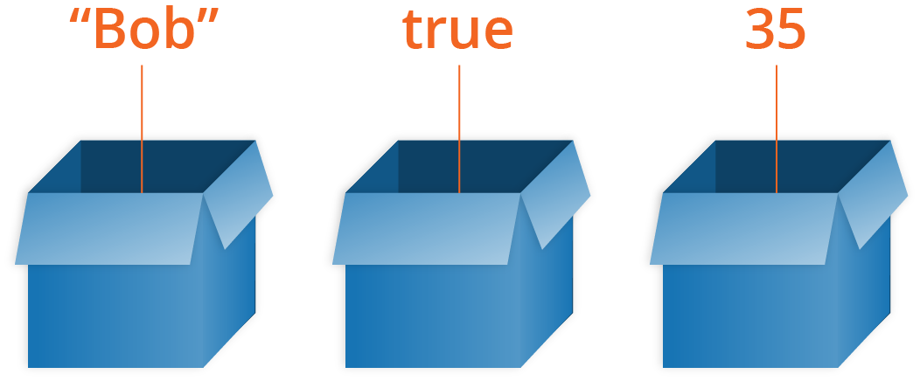

Array
Arrays are container-like values that can hold other values. The values inside an array are called elements.

Slide 4
Array
let mobil1 = 'Alya';
let mobil2 = 'Xenia';
let mobil3 = 'Avanza';
=============================
let mobil = ['Alya','Xenia','Avanza'];
let mobil = [
'Alya',
'Xenia',
'Avanza'
];

Slide 5
Array
let mobil = ['Alya','Xenia','Avanza'];
console.log(mobil)
console.log(mobil.toString())
console.log(mobil.join(' * '))

Slide 6
Array Elements
let mobil = ['Alya','Xenia','Avanza'];
console.log(mobil[0])
console.log(mobil[1])
console.log(mobil[2])
console.log(mobil[3])

Slide 7
Array Elements
let buah, bPjg, i;
buah = ['Jeruk', 'Nanas', 'Apel'];
bPjg = buah.length;
for (i = 0; i < bPjg; i++) {
console.log(buah[i]);
}

Slide 8
Array Properties & Methods
< length, sort, reverse & indexOf >
let mobil = ['Alya','Xenia','Avanza'];
let w = mobil.length;
let x = mobil.sort();
//let y = mobil.reverse();
let z = mobil.indexOf('Avanza');
console.log(w)
console.log(x)
// console.log(y)
console.log(z)

Slide 9
pop & push
let buah = ['Jeruk','Nanas','Apel'];
buah.pop();
console.log(buah)
buah.push('Kiwi');
console.log(buah)

Slide 10
shift & unshift
let buah = ['Jeruk','Nanas','Apel'];
buah.shift();
console.log(buah)
buah.unshift('Lemon');
console.log(buah)

Slide 11
delete & splice
let buah = ['Jeruk','Nanas','Apel'];
buah.splice(2, 0, 'Lemon', 'Kiwi');
console.log(buah)
buah.splice(0, 1);
console.log(buah)
delete buah[0];
console.log(buah)

Slide 12
slice
let buah = ['Banana', 'Orange',
'Lemon', 'Apple', 'Mango'];
let buah2 = buah.slice(1);
console.log(buah2)
let buah4 = buah.slice(1,4);
console.log(buah4)

Slide 13
Adding Array Elements
let buah = ['Jeruk','Nanas','Apel'];
buah.push('Duku');
console.log(buah)
buah[buah.length] = 'Pisang';
console.log(buah)
buah[6] = 'Mangga';
console.log(buah)

Slide 14
Merging (Concatenating)
2 Arrays
let nama1 = ['Andi','Budi'];
let nama2 = ['Caca','Dede','Euis'];
let nama3 = nama1.concat(nama2);
let nama4 = nama2.concat(nama1);
console.log(nama3)
console.log(nama4)

Slide 15
Merging (Concatenating)
3 Arrays
let nama1 = ['Andi','Budi'];
let nama2 = ['Caca','Dede','Euis'];
let nama3 = ['Faza','Gilang'];
let x = nama1.concat(nama2,nama3);
console.log(nama1)
console.log(nama2)
console.log(nama3)
console.log(x)

Slide 16
Solve It!
Buatlah algoritma untuk mengurutkan elemen array berikut:
x = [40, 100, 1, 5, 25, 10]

Slide 17
Numeric Sorting Ascending
Function comparison
let x = [40, 100, 1, 5, 25, 10];
console.log(x)
console.log(x.sort())
x.sort(function(a,b){
return a-b
});
console.log(x)

Slide 18
Numeric Sorting Descending
Function comparison
let x = [40, 100, 1, 5, 25, 10];
console.log(x)
console.log(x.sort())
x.sort(function(a,b){
return b-a
});
console.log(x)

Slide 19
Solve It!
Buatlah algoritma untuk menentukan elemen tertinggi & terendah,
dari array berikut:
x = [40, 100, 1, 5, 25, 10]

Slide 20
Lowest & Highest Element #1
let x = [40, 100, 1, 5, 25, 10];
x.sort(function(a,b){
return a-b
});
console.log(x[0])
console.log(x[x.length-1])

Slide 21
Lowest & Highest Element #2
let x = [40, 100, 1, 5, 25, 10];
function nilaiMin(a) {
return Math.min.apply(null, a);
}
function nilaiMax(a) {
return Math.max.apply(null, a);
}
console.log(nilaiMin(x))
console.log(nilaiMax(x))

Slide 22
Array of Arrays
var arrayKu = [
['Andi',24,'PNS'],
['Budi',28,'Pengacara'],
['Caca',21,'Siswa'],
]
console.log(arrayKu[0])
console.log(arrayKu[0][0])
console.log(arrayKu[1][1])
console.log(arrayKu[2][2])

Slide 23
Sorting Array of Arrays
var arrayKu = [
['Andi',24,'PNS'],
['Budi',28,'Pengacara'],
['Caca',21,'Siswa'],
]
arrayKu[0].sort()
arrayKu[1].reverse()
console.log(arrayKu[0])
console.log(arrayKu[1])

Slide 24
Learning Resources
https://www.w3schools.com/js/js_arrays.asp
https://www.w3schools.com/js/js_array_methods.asp
https://www.w3schools.com/js/js_array_sort.asp
https://www.w3schools.com/js/js_array_iteration.asp

Slide 25
Exploring
#6 Function & Array

